Slide 1
Unit III
Protein synthesis
Secondary structure of the protein
Structure and function
Structural databases
Protein visualizing tools
Secondary structure prediction algorithms

Slide 2
Protein Synthesis

Slide 3
Protein Synthesis
DNA
The production (synthesis) of polypeptide chains (proteins)
Two phases: Transcription & Translation
mRNA must be processed before it leaves the nucleus of eukaryotic cells
Transcription
Prokaryotic Cell
mRNA
Translation
Ribosome
Protein
Nuclear membrane
Eukaryotic Cell
DNA
Transcription
Pre-mRNA
RNA Processing
mRNA
Ribosome
Translation
Protein
Notes:
‹#›
‹#›

Slide 4
Three Types of RNA
.
Messenger RNA (mRNA) carries genetic information to the ribosomes
(blueprint for the construction of a protein)
Ribosomal RNA (rRNA), along with protein, makes up the ribosomes
(construction site where the protein is made)
Transfer RNA (tRNA) transfers amino acids to the ribosomes where proteins are synthesized
(truck delivering the proper amino acid to the site at the right time)
Notes:
‹#›
‹#›

Slide 5
Genes & Proteins
Proteins are made of amino acids linked together by peptide bonds
20 different amino acids exist
Amino acids chains are called polypeptides
Segment of DNA that codes for the amino acid sequence in a protein are called genes
Genetic Code:
DNA contains a triplet code
Every three bases on DNA stands for ONE amino acid
Each three-letter unit on mRNA is called a codon
Most amino acids have more than one codon!
There are 20 amino acids with a possible 64 different triplets
The code is nearly universal among living organisms
Notes:
‹#›
The fact that the genetic code is about universal in living things suggests that the code dates back to the first organisms on earth and that all living things are related.
‹#›

Slide 6
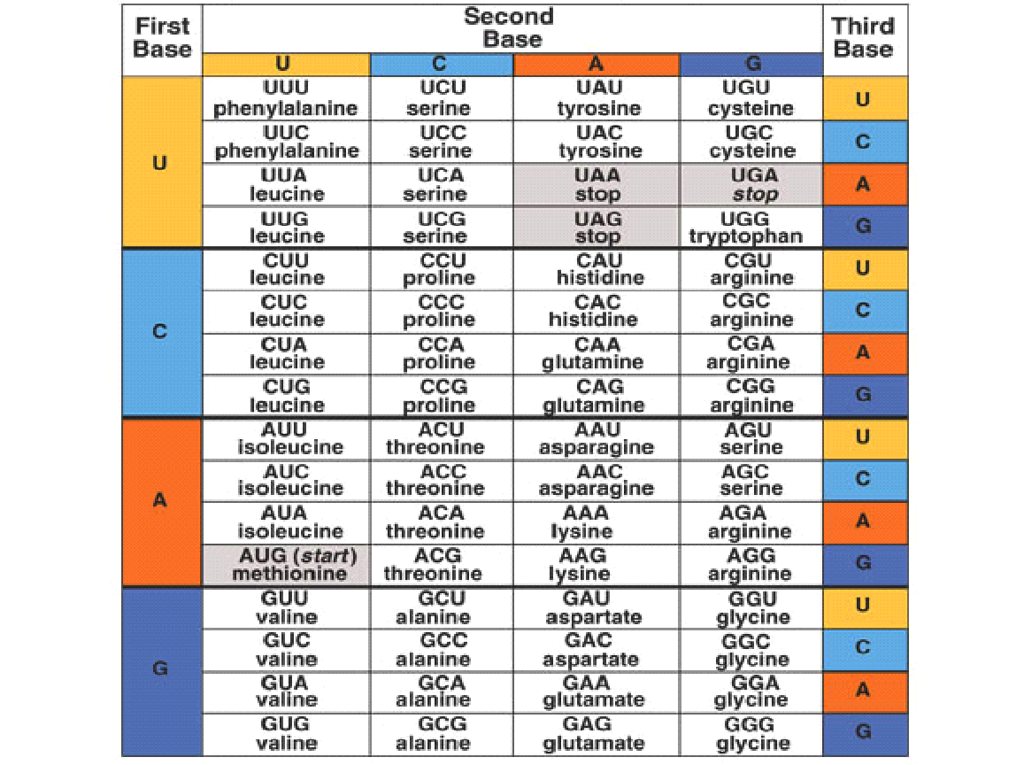
‹#›
Notes:
‹#›
‹#›
Notice that in this chart, each of the codons (white rectangles) is composed of three letters representing the first base, second base, and third base. For example, find the rectangle where C for the first base and A for the second base intersect. You will see that U, C, A, or G can be the third base. CAU and CAC are codons for histidine; CAA and CAG are codons for glutamine.

Slide 7
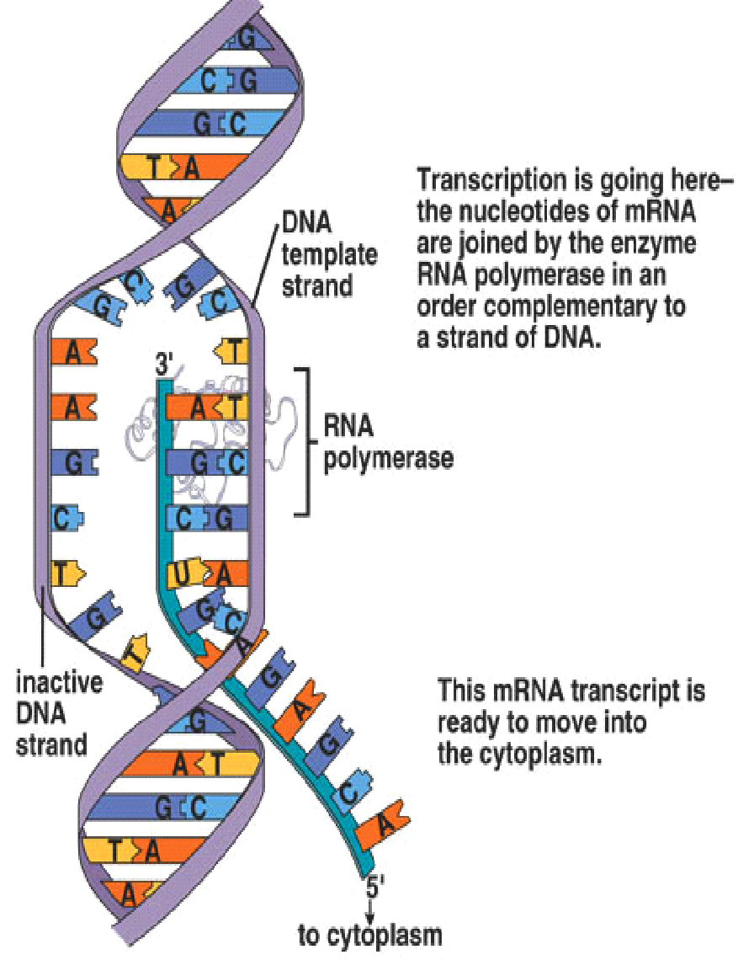
Overview of Transcription
During transcription in the nucleus, a segment of DNA unwinds and unzips, and the DNA serves as a template for mRNA formation
RNA polymerase joins the RNA nucleotides so that the codons in mRNA are complementary to the triplet code in DNA
The transfer of information in the nucleus from a DNA molecule to an RNA molecule
Only 1 DNA strand serves as the template
Starts at promoter DNA (TATA box)
Ends at terminator DNA (stop)
When complete, pre-RNA molecule is released
Notes:
‹#›
During transcription, complementary RNA is made from a DNA template. A portion of DNA unwinds and unzips at the point of attachment of RNA polymerase. A strand of mRNA is produced when complementary bases join in the order dictated by the sequence of bases in DNA. Transcription occurs in the nucleus, and the mRNA passes out of the nucleus to enter the cytoplasm.
‹#›

Slide 8
RNA Polymerase
Enzyme found in the nucleus
Separates the two DNA strands by breaking the hydrogen bonds between the bases
Then moves along one of the DNA strands and links RNA nucleotides together
DNA
RNA Polymerase
pre-mRNA
Notes:
‹#›
‹#›

Slide 9
Processing Pre-mRNA
Also occurs in the nucleus
Pre-mRNA made up of segments called introns & exons
Exons code for proteins, while introns do NOT!
Introns spliced out by splicesome-enzyme and exons re-join
End product is a mature RNA molecule that leaves the nucleus to the cytoplasm
pre-RNA molecule
exon
intron
exon
intron
exon
intron
intron
exon
exon
exon
splicesome
splicesome
exon
exon
exon
Mature RNA molecule
Notes:
‹#›
‹#›

Slide 10
Messenger RNA (mRNA)
Carries the information for a specific protein
Made up of 500 to 1000 nucleotides long
Sequence of 3 bases called codon
AUG – methionine or start codon
UAA, UAG, or UGA – stop codons
start
codon
A
U
G
G
G
C
U
C
C
A
U
C
G
G
C
G
C
A
U
A
A
mRNA
codon 1
codon 2
codon 3
codon 4
codon 5
codon 6
codon 7
protein
methionine
glycine
serine
isoleucine
glycine
alanine
stop
codon
Primary structure of a protein
aa1
aa2
aa3
aa4
aa5
aa6
peptide bonds
Notes:
‹#›
‹#›

Slide 11
Transfer RNA (tRNA)
Made up of 75 to 80 nucleotides long
Picks up the appropriate amino acid floating in the cytoplasm
Transports amino acids to the mRNA
Have anticodons that are complementary to mRNA codons
Recognizes the appropriate codons on the mRNA and bonds to them with H-bonds
Four ATP’s are required for each amino acid added to the polypeptide chain:Two to "charge" the tRNA , one to carry the charged tRNA to the ribosome and one to move the ribosome to the next codon.
amino acid
attachment site
methionine
U
A
C
anticodon
Notes:
‹#›
‹#›

Slide 12
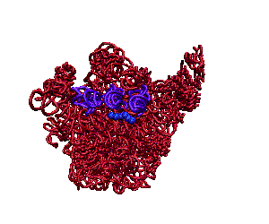
Ribosomal RNA (rRNA)
Made up of rRNA is 100 to 3000 nucleotides long
Made inside the nucleus of a cell
Associates with proteins to form ribosomes
Ribosomes
Made of a large and small subunit
Composed of rRNA (40%) and proteins (60%)
Have two sites for tRNAP and A
Notes:
‹#›
‹#›

Slide 13
Ribosomes
P= Peptide site
A= Amino acid site
Large
subunit
P
Site
A
Site
mRNA
A
U
G
C
U
A
C
U
U
C
G
Small subunit
Notes:
‹#›
‹#›

Slide 14
Translation
Synthesis of proteins in the cytoplasm
Involves the following:
1. mRNA (codons)
2. tRNA (anticodons)
3. ribosomes
4. amino acids
Three steps:
1. initiation: start codon (AUG)
2. elongation: amino acids linked
3. termination: stop codon (UAG, UAA, or UGA).
Notes:
‹#›
‹#›

Slide 15
mRNA Codons Join the Ribosome
Large
subunit
P
Site
A
Site
mRNA
A
U
G
C
U
A
C
U
U
C
G
Small subunit
Notes:
‹#›
‹#›

Slide 16
Initiation
aa2
aa1
2-tRNA
1-tRNA
G
A
U
anticodon
U
A
C
hydrogen
bonds
A
U
G
C
U
A
C
U
U
C
G
A
codon
mRNA
Notes:
‹#›
‹#›

Slide 17
Elongation
peptide bond
aa3
aa1
aa2
3-tRNA
G
A
A
1-tRNA
2-tRNA
anticodon
U
A
C
G
A
U
hydrogen
bonds
A
U
G
C
U
A
C
U
U
C
G
A
codon
mRNA
Notes:
‹#›
‹#›

Slide 18
aa1
peptide bond
aa3
aa2
1-tRNA
U
A
C
3-tRNA
(leaves)
G
A
A
2-tRNA
G
A
U
A
U
G
C
U
A
C
U
U
C
G
A
mRNA
Ribosomes move over one codon
Notes:
‹#›
‹#›

Slide 19
peptide bonds
aa1
aa4
aa2
aa3
4-tRNA
G
C
U
2-tRNA
3-tRNA
G
A
U
G
A
A
A
U
G
C
U
A
C
U
U
C
G
A
A
C
U
mRNA
Notes:
‹#›
‹#›

Slide 20
peptide bonds
aa1
aa4
aa2
aa3
2-tRNA
4-tRNA
G
A
U
(leaves)
G
C
U
3-tRNA
G
A
A
A
U
G
C
U
A
C
U
U
C
G
A
A
C
U
mRNA
Ribosomes move over one codon
Notes:
‹#›
‹#›

Slide 21
peptide bonds
aa5
aa1
aa2
aa4
aa3
5-tRNA
U
G
A
3-tRNA
4-tRNA
G
A
A
G
C
U
G
C
U
A
C
U
U
C
G
A
A
C
U
mRNA
Notes:
‹#›
‹#›

Slide 22
peptide bonds
aa5
aa1
aa2
aa3
aa4
5-tRNA
3-tRNA
U
G
A
G
A
A
4-tRNA
G
C
U
G
C
U
A
C
U
U
C
G
A
A
C
U
mRNA
Ribosomes move over one codon
Notes:
‹#›
‹#›

Slide 23
aa5
aa4
aa199
Termination
aa3
primary
structure
of a protein
aa200
aa2
aa1
terminator
or stop
codon
200-tRNA
A
C
U
C
A
U
G
U
U
U
A
G
mRNA
Notes:
‹#›
‹#›

Slide 24
End Product –The Protein!
The end products of protein synthesis is a primary structure of a protein
A sequence of amino acid bonded together by peptide bonds
aa5
aa4
aa3
aa2
aa199
aa1
aa200
‹#›
Notes:
‹#›
Protein synthesis animation @
Transcription- https://dnalc.cshl.edu/resources/3d/15-translation-basic.html
Translation- https://dnalc.cshl.edu/resourceshttps://dnalc.cshl.edu/resources/3d/15-translation-basic.html/3d/15-translation-basic.html
‹#›

Slide 25
Classification of Proteins
Based on the chemical nature, structure, shape, and solubility, proteins are classified as:
Simple proteins: They are composed of only amino acid residue. On hydrolysis, these proteins yield only constituent amino acids. It is further divided into:
Fibrous protein: Keratin, Elastin, Collagen
Globular protein: Albumin, Globulin, Glutelin, Histones
Conjugated proteins: They are combined with non-protein moiety. Eg. Nucleoprotein, Phosphoprotein, Lipoprotein, Metalloprotein, etc.
Derived proteins: They are derivatives or degraded products of simple and conjugated proteins. They may be
Primary derived protein: Proteans, Metaproteins, Coagulated proteins
Secondary derived proteins: Proteosesn or albunoses, peptones, peptides.

Slide 26
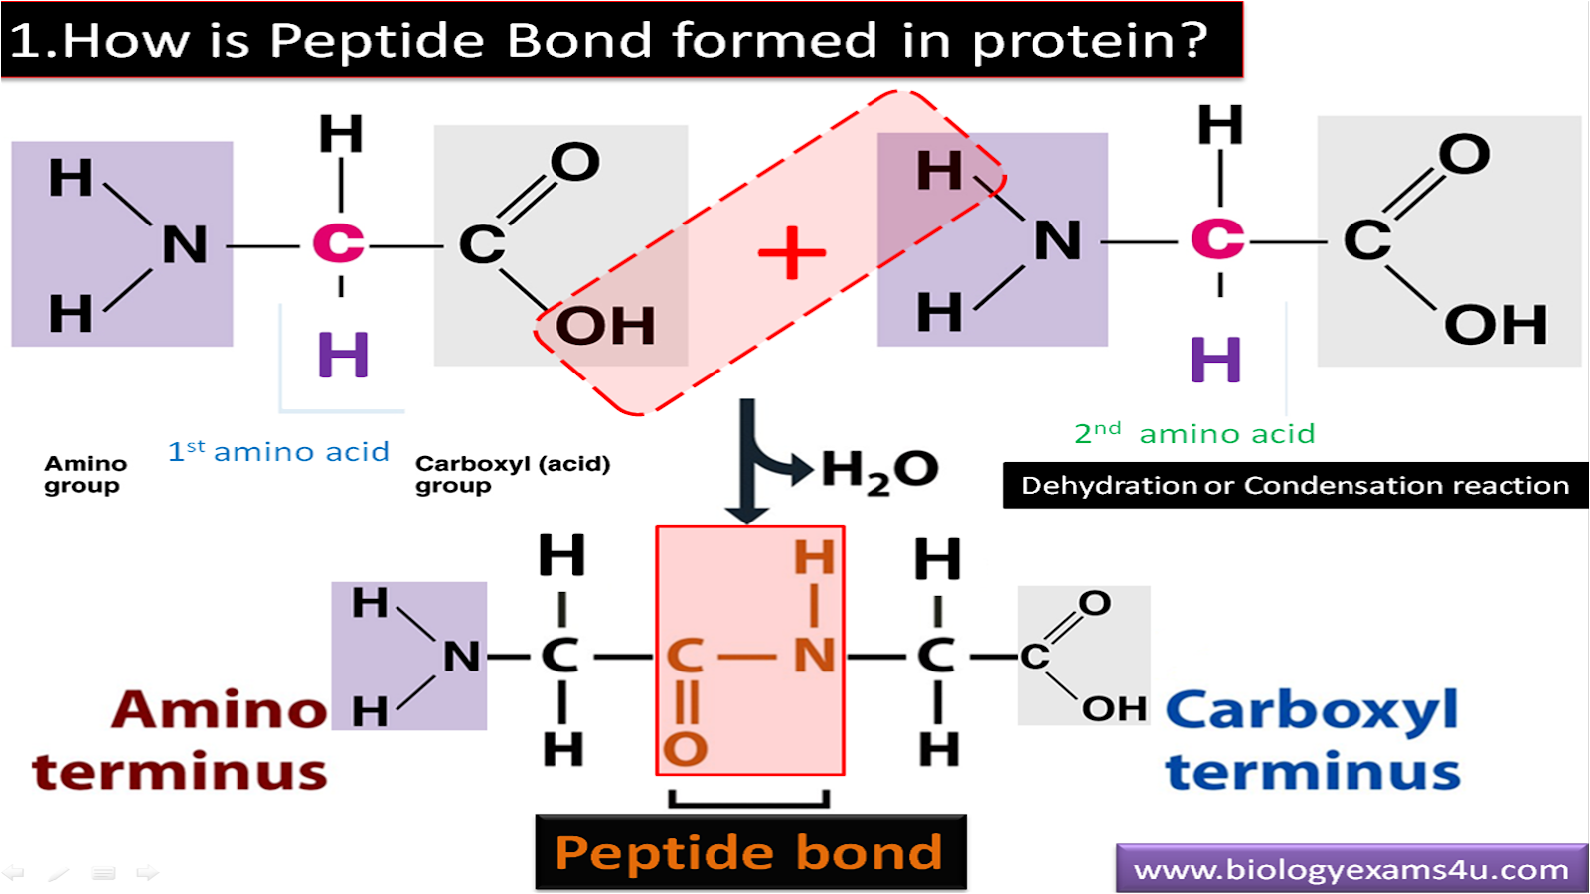
Structure of a protein
1. Primary Structure
The primary structure of a protein consists of the amino acid sequence along the polypeptide chain. Amino acids are joined by peptide bonds.
2. Secondary Structure
Alpha-helix: The α-helix is a right-handed coiled strand. The side-chain substituents of the amino acid groups in an α-helix extend to the outside. Hydrogen bonds form between the oxygen of the C=O bond of a aminoacid to hydrogen of the N-H group of the fourth amino acids below it in the helix.
Beta Sheet:The hydrogen bonding in a ß-sheet is between strands (inter-strand) The sheet conformation consists of pairs of strands lying side-by-side. The carbonyl oxygens in one strand hydrogen bond with the amino hydrogens of the adjacent strand.
3. Tertiary Structure
The tertiary structure of a protein refers to its overall three-dimensional conformation.
The types of interactions between amino acid residues that produce the three-dimensional shape of a protein include hydrophobic interactions, electrostatic interactions, and hydrogen bonds, all of which are non-covalent and Covalent disulfide bonds also occur.
4. Quaternary Structure
Quaternary structure refers to the interaction of one or more subunits to form a functional protein, using the same forces that stabilize the tertiary structure.It is the spatial arrangement of subunits in a protein that consists of more than one polypeptide chain.

Slide 27
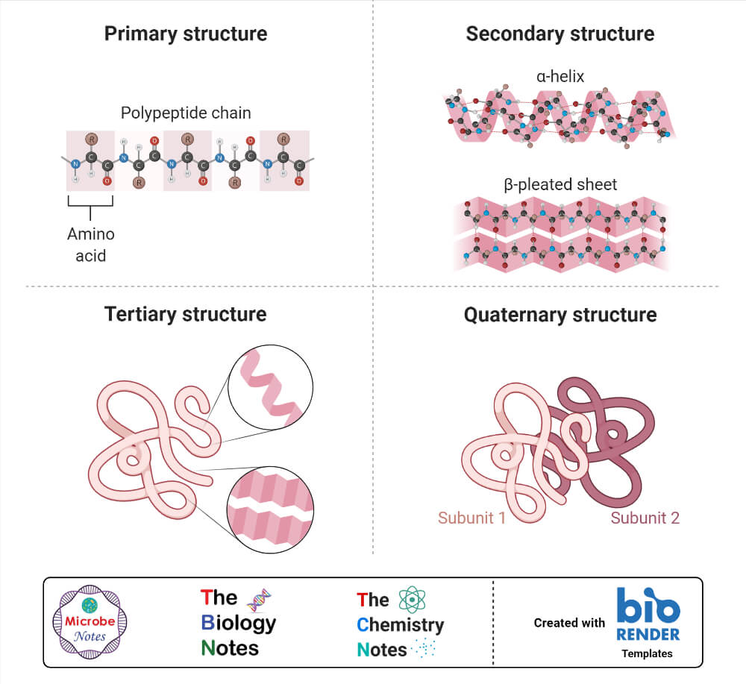

Slide 28
Classes of Protein Structure
The function of a protein depends heavily on its final structure. Tertiary and quaternary proteins are both functional proteins with a 3D structure. However, the type of structure can vary significantly between different proteins.
There are two main classes of 3D protein structure: globular proteins and fibrous proteins.
Globular Proteins
Globular proteins are usually round and ball-shaped. They usually have metabolic functions, for example, they may be enzymes or antibodies. Haemoglobin is an example of a globular protein.
Fibrous Proteins
Fibrous proteins are long and narrow and usually have a structural function. Examples of fibrous proteins include collagen (found in bones, muscle, and skin) and keratin (the material that makes up hair, nails, and feathers).
Notes:
Energy and Enzymes
*
G. Podgorski, Biol. 1010
‹#›

Slide 29
Functional Classification of Proteins
Enzymes (biochemical catalysts)-In living organisms, almost all reactions are catalyzed by specific proteins called enzymes. They have a high catalytic power, increasing the rate of the reaction in which they are involved at least by factor 106. Eg: Glucose isomerase
Transport proteins -Many small molecules, organic and inorganic, are transported in the bloodstream and extracellular fluids, across the cell membranes, Eg: hemoglobin, that carries oxygen from the alveolar blood vessels to tissue capillaries;
Storage proteins-Examples are: ferritin, that stores iron intracellularly in a non-toxic form
Mechanical support-Proteins have a pivotal role in the stabilization of many structures. Examples are α-keratins, collagen and elastin.
Movement-Example-the contraction of the muscle fibers (of which myosin is the main component);
Nerve transmission.-An example is the receptor for acetylcholine at synapses.
Hormones- regulatory functions Example is insulin,
Protection against harmful agents.-The antibodies or immunoglobulins are glycoproteins that recognize antigens expressed on the surface of viruses, bacteria and other infectious agents.
Storage of energy-Proteins in particular the amino acids that constitute them, act as energy storage, second in size only to the adipose tissue, that in particular conditions, such as prolonged fasting, may become essential for survival

Slide 30
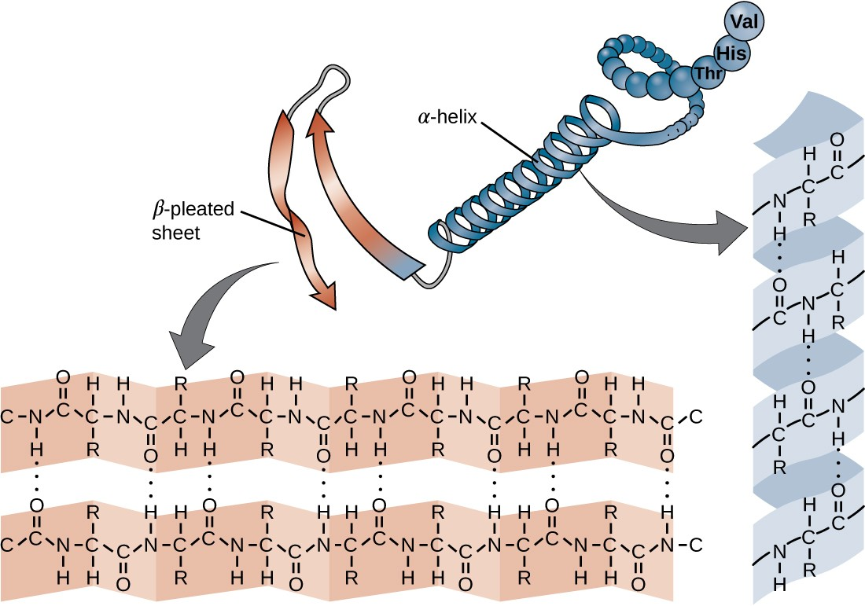
Secondary structure of a protein
The most common type of secondary structure in proteins is the α-helix.
Fingernails and toenails are also made up of alpha-helices
Beta Sheets form the core of globular proteins
The end of a polypeptide chain can either be the N-terminus or the C-terminus. The N-terminus is the end that contains the free amino group, and the C-terminus is the end that contains the free carboxyl group.
If two beta-strands run in the same direction, then it is a parallel beta-pleated sheet, and if they run in opposing directions, then it is an antiparallel beta-pleated sheet.
Notes:
Energy and Enzymes
*
G. Podgorski, Biol. 1010
‹#›

Slide 31
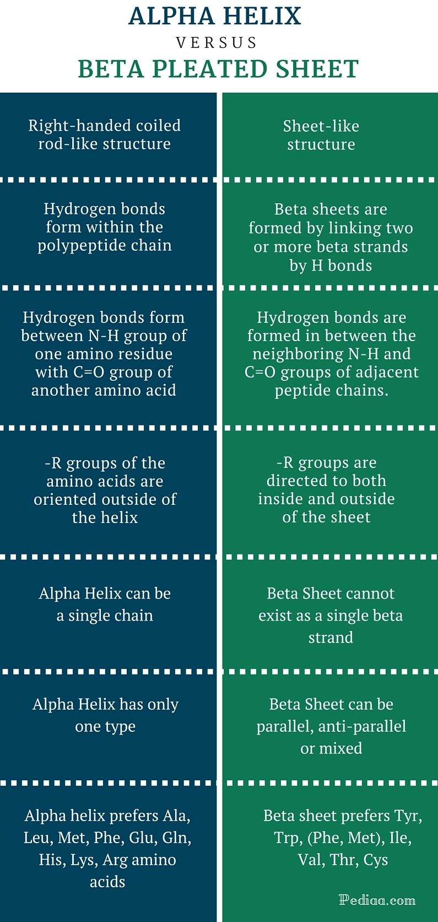

Slide 32
Clinical Implications of Secondary Structure of Proteins
The secondary structure of a protein can be altered by either a mutation in the primary sequence of amino acids that make up the protein or by extreme conditions that force the proteins to denature or lose their shape.
Spongiform encephalopathy, and Amyloidosis are two classes of disease involving changes in the secondary structure of proteins.
Both involve the misfolding of proteins into Beta sheets, and the presence of these proteins leading to tissue damage.

Slide 33
Structural databases
Protein visualizing tools
Secondary structure prediction algorithms

Slide 34
Structural Databases
Important in solving real problems in molecular biology
Protein Databank - PDB Established in 1972 at Brookhaven National Laboratory (BNL)
Sole international repository of macromolecular structure data
Moved to Research Collaboratory for Structural Bioinformatics http://www.rcsb.org

Slide 35
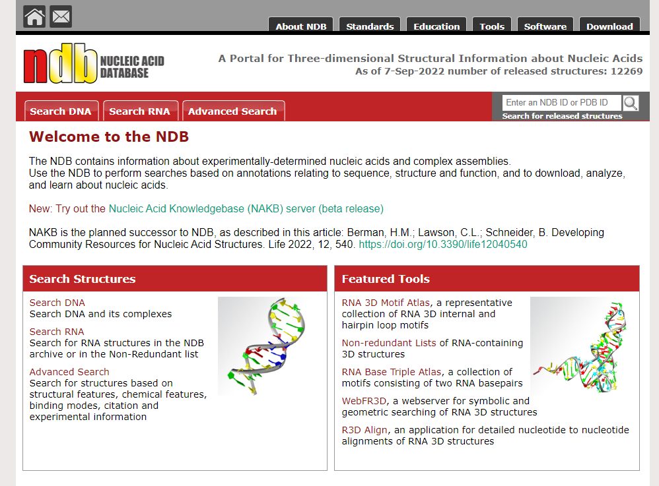
NDB: Nucleic Acid Structure Database

Slide 36
The NDB contains information about experimentally-determined nucleic acids and complex assemblies.
Use the NDB to perform searches based on annotations relating to sequence, structure and function, and to download, analyze, and learn about nucleic acids.
http://ndbserver.rutgers.edu/

Slide 37
PDB- Protein Structure database
A protein database contains the information about 3D structure of proteins.
The PDB files contain experimentally decided 3D structures of biological macromolecules.
The structural information of a protein can be determined by X–ray crystallography or Nuclear Magnetic Resonance (NMR) spectroscopy methods.
PDB allows searching for information regarding the structure, sequence, function, visualize , download and to assess molecules.
The PDB files also contains information of data collected, molecule name, primary and secondary structure, ligand, atomic coordinates, crystallographic structure factors, NMR experimental data etc..
The data are submitted by scientists from all over the world. PDB is maintained by Worldwide Protein Data Bank. All data in PDB are accessible to public

Slide 38
Each entry in the PDB is provided with a unique identification number called the PDB ID. It is a 4 letter identification number which consist of both alphanumeric characters.
Without a proper tool, the PDB file will be read as a text file that lists each atom and its numerical coordinates in 3-D space.
There are databases which contain data derived from PDB.
For example
Structural Classification of Proteins (SCOP) that groups different protein structures,
HSSP (Homology-Derived Secondary Structure of Proteins) for 3D- structure and 1D- sequence of the protein,
CATH for protein structure classification according to their evolution etc.

Slide 39
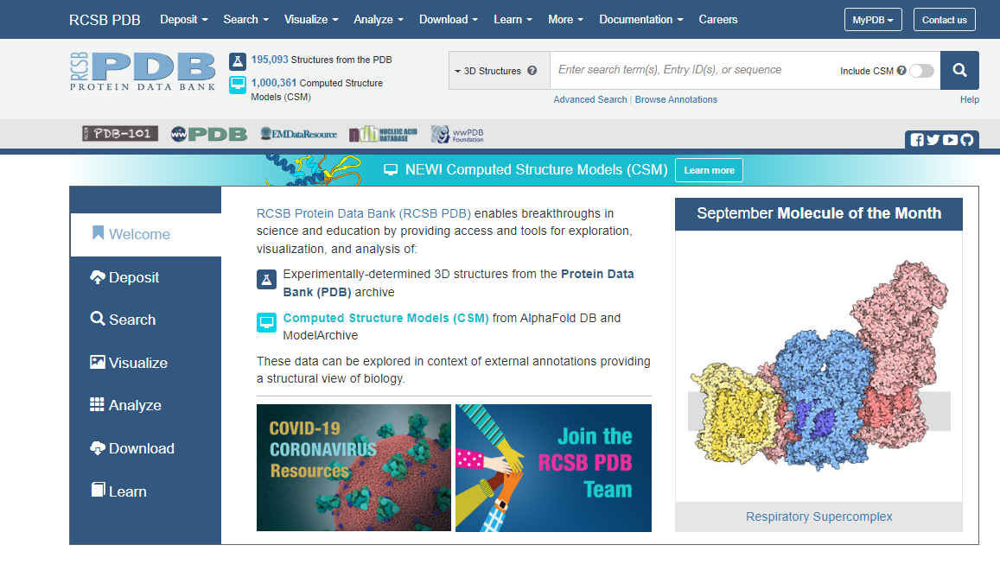

Slide 40
Protein visualizing tools Uses
To view the structures that are encoded by these atomic coordinate files (which have the extension .pdb), and
to be able to manipulate the images to view the molecules from various perspectives, requires a molecular graphics visualization tool.

Slide 41
Protein visualizing tools
Rasmol/RasTop-
RasMol is a molecular graphics program intended for the visualisation of proteins, nucleic acids and small molecules.
The program reads in a molecule coordinate file and interactively displays the molecule on the screen in a variety of colour schemes and molecule representations.
Currently available representations include depth cued wireframes, 'Dreiding' sticks, spacefilling (CPK) spheres, ball and stick, solid and strand biomolecular ribbons, atom labels and dot surfaces.

Slide 42

Pymol
PyMOL is a molecular graphics system with an embedded Python interpreter designed for real-time visualization and rapid generation of high-quality molecular graphics images and animations.

Slide 43
PyMol is a powerful molecule visualization software with the following main features:
Able to produce high-quality graphics ready for publications.
Able to create movies.
Able to measure bond distances and angles.
Has an extensive help system.
Structures can be sliced, diced, and reassembled on the fly and written out to standard files.
Both command line interface and graphical user interface are provided.
Python API is provided to access all functionalities.

Slide 44
Online Visualizer
A PDB CODE (e.g. 1B8G)
Go to the Structure Home Page-https://www.ncbi.nlm.nih.gov/sites/entrez?db=Structure
Enter the PDB code in the search box and press the Go button.
Click a structure image to access its record page
Scroll to the molecular graphic section and click on the spin icon to load an interactive view of the structure within the web page. Alternatively, click on the launch icon to open the advanced (full feature) version of iCn3D, NCBI's web-based 3D structure viewer, in a separate window.

Slide 45
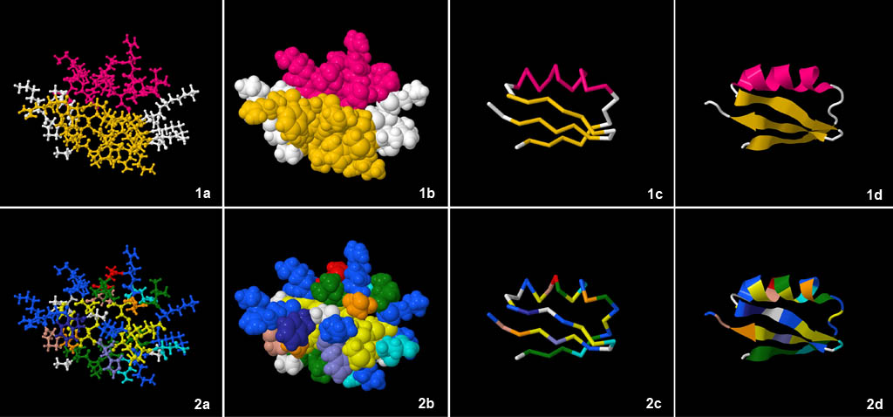
One protein, one true structure, eight ways to look at it using a molecular visualization tool
Pink is for helix and yellow for sheet

Slide 46
Ball and stick model - 1a show the main atoms in all of the protein’s amino acids.
Space filling model - In 1b you can see how much space each atom actually occupies. This is closest to the protein's actual shape.
Backbone model - In 1c, all the details of the different amino acids have been removed and all that remains is a stick drawing showing where the protein's backbone goes.
Ribbon (or cartoon) model - In 1d the individual amino acid structures have again been removed, but the flattened ribbon areas highlight places where the amino acids come together to form spirals (helices) or sheets. This makes it easier to visualize important secondary structures in the protein.

Slide 47
Secondary structure prediction algorithm
The secondary structure prediction methods can be either
ab initio based, which make use of single sequence information only, or
homology based, which make use of multiple sequence alignment information.

Slide 48
The ab initio methods, which belong to early generation methods, predict secondary structures based on statistical calculations of the residues of a single query sequence.
The homology-based methods do not rely on statistics of residues of a single sequence, but on common secondary structural patterns conserved among multiple similar sequences.

Slide 49
Ab Initio–Based Methods
It measures the relative propensity(Natural tendency) of each amino acid belonging to a certain secondary structure element.
The propensity scores are derived from known crystal structures.
Examples of ab initio prediction are the Chou–Fasman and Garnier, Osguthorpe, Robson (GOR) algorithms

Slide 50
The Chou–Fasman algorithm
( http://fasta.bioch.virginia.edu/fasta/chofas.htm )
determines the propensity or intrinsic tendency of each residue to be in the helix, strand, and β-turn conformation using observed frequencies found in protein crystal structures.

Slide 51
Homology-Based Methods
This type of method combines the ab initio secondary structure prediction of individual sequences and alignment information from multiple similar sequences (>35% identity).
The idea behind this approach is that close protein homologs should adopt the same secondary and tertiary structure.
This homology based method has helped improve the prediction accuracy by another 10% over the second-generation methods.
Eg.,- PHD

Slide 52
PHD – neural network algorithm for secondary structure prediction
PHD are neural network systems (a sequence-to-structure level and a structure-structure level)to predict secondary structure (PHDsec)
PHDsec focuses on predicting hydrogen bonds. The use of the evolutionary information held by a multiple sequence alignment increases the prediction accuracy.
PHD uses two levels of Neural Networks • trained networks
Notes:
NPS@ help : Help on PHD tool (ibcp.fr)- more details of PHD
Energy and Enzymes
*
G. Podgorski, Biol. 1010
‹#›

Slide 53
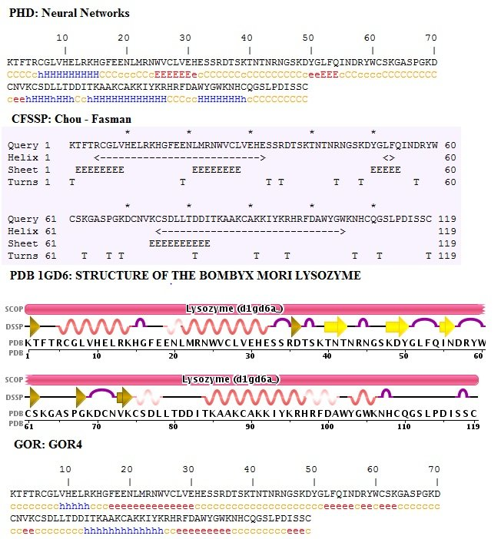
Notes:
Energy and Enzymes
*
G. Podgorski, Biol. 1010
‹#›

Slide 54
How good are the methods?
Single sequence, single residue methods Chou & Fasman -50%
Single sequence, multiple residues methods GOR IV -65%
Multiple sequence methods
PHD 71%

Slide 55
THANKYOU

